Slide 1
Machine Learning

Slide 2
Traditional Software Development

Slide 3
Traditional Software Development
Convert inches to cm

Slide 4
Traditional Software Development
Convert inches to cm
Input:
Output:

Slide 5
Traditional Software Development
Convert inches to cm
Input: inches
Output:

Slide 6
Traditional Software Development
Input: inches
Relationship: cm =
Output:

Slide 7
Traditional Software Development
Input: inches
Relationship: cm = inches * 2.54
Output:

Slide 8
Traditional Software Development
Input: inches
Relationship: cm = inches * 2.54
Output: cm

Slide 9
Traditional Software Development

Slide 10
Traditional Software Development
Convert a number to its absolute value

Slide 11
Traditional Software Development
Convert a number to its absolute value
Input:
Output:

Slide 12
Traditional Software Development
Convert a number to its absolute value
Input: number
Output:

Slide 13
Traditional Software Development
Convert a number to its absolute value
Input: number
Rules:
Output:

Slide 14
Traditional Software Development
Input: number
Rules:
if number >= 0: abs. value = number
Output:

Slide 15
Traditional Software Development
Input: number
Rules:
if number >= 0: abs. value = number
Output:

Slide 16
Traditional Software Development
Input: number
Rules:
if number >= 0: abs. value = number
else: abs. value = number * -1
Output:

Slide 17
Traditional Software Development
Input: number
Rules:
if number >= 0: abs. value = number
else: abs. value = number * -1
Output: abs. value

Slide 18
Traditional Software Development

Slide 19
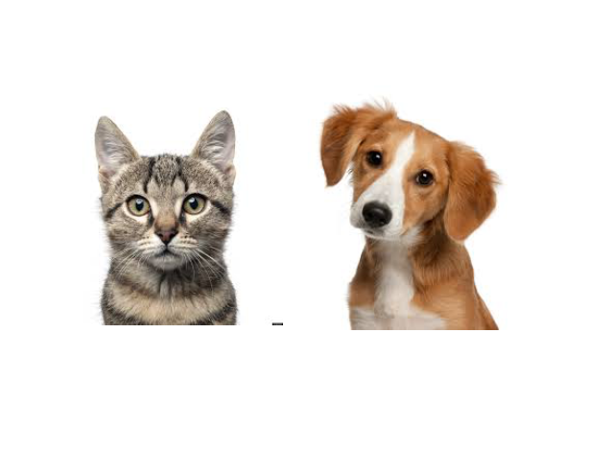
Traditional Software Development

Slide 20
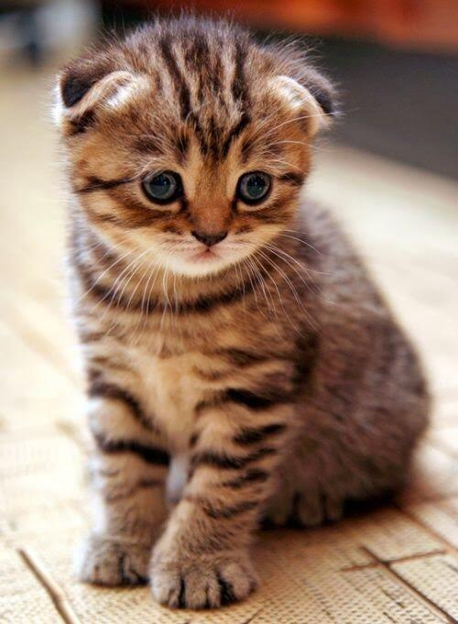

Slide 21
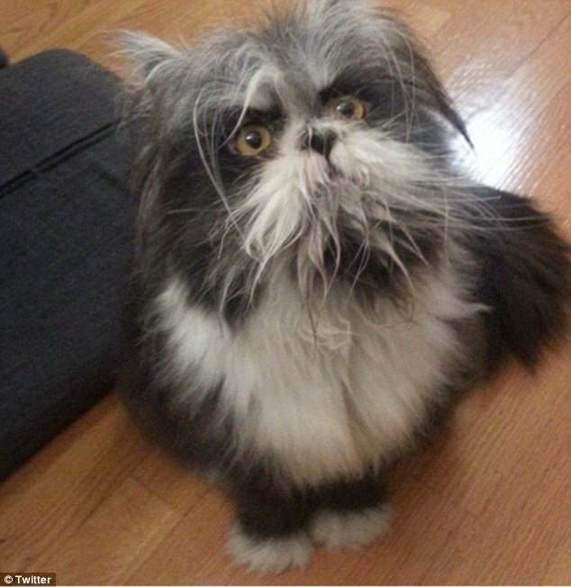

Slide 22
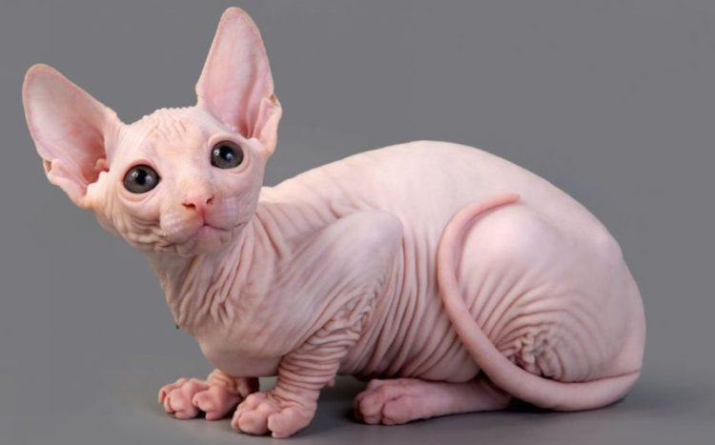

Slide 23
Traditional Software Development
Input:
Rules:
Output:

Slide 24
Traditional Software Development
Input:
Rules: rule 1
rule 2
rule 3 …
Output:

Slide 25
Traditional Software Development
Input:
Rules: rule 1
rule 2
rule 3 …
Output: “cat”

Slide 26
Machine Learning

Slide 27
Machine Learning
Input | 0 | 8 | 15 | 22 | 38
Output | 32 | 46.4 | 59 | 71.6 | ?

Slide 28
Machine Learning
Input | 0 | 8 | 15 | 22 | 38
Output | 32 | 46.4 | 59 | 71.6 | 100.4

Slide 29
F = C * 1.8 + 32
Celsius | 0 | 8 | 15 | 22 | 38
Fahrenheit | 32 | 46.4 | 59 | 71.6 | 100.4

Slide 30
Machine Learning
Input: [0, 8, 15 22]

Slide 31
Machine Learning
Input: [0, 8, 15 22]
Output: [32, 46.4, 59, 71.6]

Slide 32
Machine Learning
Input: [0, 8, 15 22]
Relationship: ?
Output: [32, 46.4, 59, 71.6]

Slide 33

Common ML Algorithms
Linear Regression
Logistic Regression
Naïve Bayes
Support Vector Machine
Decision Tree
K-Nearest Neighbor
=

Slide 34
Machine Learning
Input: [0, 8, 15 22]
Relationship:
Output: [32, 46.4, 59, 71.6]

Slide 35
Machine Learning
Input: [0, 8, 15 22]
Relationship: input *1.8 + 32
Output: [32, 46.4, 59, 71.6]

Slide 36
Machine Learning
Input: [0, 8, 15 22]
Model
Relationship: input *1.8 + 32
Output: [32, 46.4, 59, 71.6]

Slide 37
Machine Learning
ML Model
input *1.8 + 32

Slide 38
Machine Learning
ML Model
New input: 38
input *1.8 + 32

Slide 39
Machine Learning
ML Model
New input: 38
input *1.8 + 32
output: 100.4

Slide 40


DATA
ALGORITHM
MODEL

Slide 41

DATA
ALGORITHM
MODEL
NEW DATA
MODEL
PREDICTIONS

Slide 42
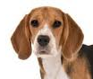
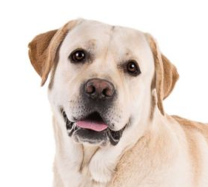
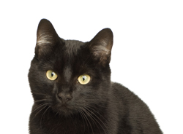

Machine Learning
Input:[ , , , ]
Relationship:
Output: [“cat”, “dog”, “dog”, “cat]

Slide 43
Machine Learning
Input:[ , , , ]
Relationship:
Output: [“cat”, “dog”, “dog”, “cat]

Slide 44
Pareidolia

Slide 46
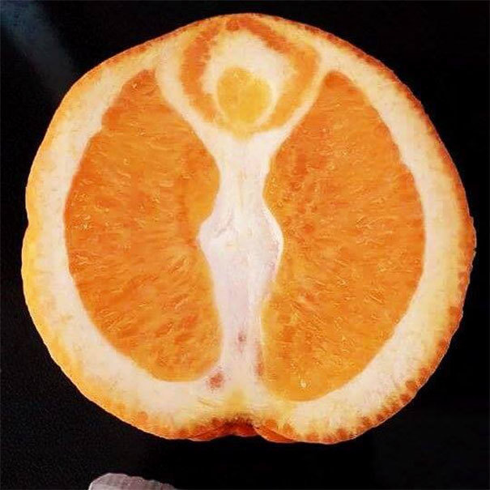

Slide 47
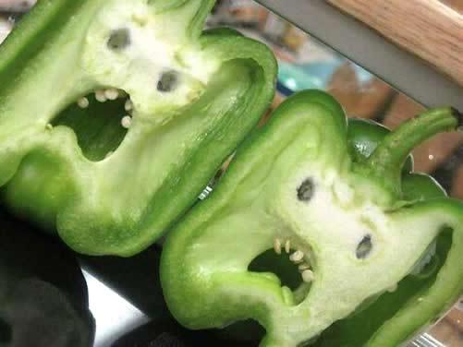

Slide 48
Machine Learning
Instead of programming a computer, you give a computer examples and it learns what you want.

Slide 49
Why ML Now?

Slide 50
Why ML Now?
Increasing availability of data

Slide 51
Why ML Now?
Increasing availability of data
Sophistication of ML algorithms

Slide 52
Why ML Now?
Increasing availability of data
Sophistication of ML algorithms
Increasing power and availability of computing hardware and software

Slide 53
Types of Machine Learning

Slide 54
Supervised
Unsupervised

Slide 55

Music
Song | Artist | Genre | Liked
Breathing Light | Frameworks | Alternative Rock | Yes
Superior | Silver Maple | Pop | No
Icicle | AK | Pop | No
Jazzin | Flap Jack | R&B | Yes
The Way You Do | Schlomo | R&B | Yes
Mirror Maru | Cashmere | Rock | Yes
Never Too Far | Sorrow | Pop | No

Slide 56
Music
Features
(X)
Song | Artist | Genre | Liked
Breathing Light | Frameworks | Alternative Rock | Yes
Superior | Silver Maple | Pop | No
Icicle | AK | Pop | No
Jazzin | Flap Jack | R&B | Yes
The Way You Do | Schlomo | R&B | Yes
Mirror Maru | Cashmere | Rock | Yes
Never Too Far | Sorrow | Pop | No

Slide 57
Music
Song | Artist | Genre | Liked
Breathing Light | Frameworks | Alternative Rock | Yes
Superior | Silver Maple | Pop | No
Icicle | AK | Pop | No
Jazzin | Flap Jack | R&B | Yes
The Way You Do | Schlomo | R&B | Yes
Mirror Maru | Cashmere | Rock | Yes
Never Too Far | Sorrow | Pop | No
Target
(y)

Slide 58
Music
Song | Artist | Genre | Liked
Breathing Light | Frameworks | Alternative Rock | Yes
Superior | Silver Maple | Pop | No
Icicle | AK | Pop | No
Jazzin | Flap Jack | R&B | Yes
The Way You Do | Schlomo | R&B | Yes
Mirror Maru | Cashmere | Rock | Yes
Never Too Far | Sorrow | Pop | No
Labels

Slide 59
Supervised
Unsupervised
Features | Label
 | Yes
 | No
 | No
 | Yes
 | Yes
 | Yes
 | No
Features | Label

Slide 60
Clustering

Slide 61
Clustering

Slide 62
Clustering
Pop
genre
Rock

Slide 63
Clustering
‘90s
decade
‘00s

Slide 64
Supervised
Unsupervised
Regression
Clustering
Classification

Slide 65
Data

Slide 66
The best data has 3 qualities:
Clean
Coverage
Complete

Slide 67
The best data has 3 qualities:
Feature 1 | Feature 2 | Feature 3 | Feature 4
Male | 200 | 1 | Yes
Female | 316 | 3 | No
F | 190 | 1 | No
Male | 244 |  | Yes
Male | 128 | 2 | Yes
Male |  | 3 | Yes
Female | 302 | 2 | No

Slide 68
Clean
Feature 1 | Feature 2 | Feature 3 | Feature 4
Male | 200 | 1 | Yes
Female | 316 | 3 | No
F | 190 | 1 | No
Male | 244 | 13 | Yes
Male | 128 | 2 | Yes
Male |  | 3 | Yes
Female | 302 | 2 | No

Slide 69
Coverage
Feature 1 | Feature 2 | Feature 3 | Feature 4
Male | 200 | 1 | Yes
Female | 316 | 3 | No
F | 190 | 1 | No
Male | 244 |  | Yes
Male | 128 | 2 | Yes
Male |  | 3 | Yes
Female | 302 | 2 | No
depth

Slide 70
Complete
breadth
Feature 1 | Feature 2 | Feature 3 | Feature 4
Male | 200 | 1 | Yes
Female | 316 | 3 | No
F | 190 | 1 | No
Male | 244 |  | Yes
Male | 128 | 2 | Yes
Male |  | 3 | Yes
Female | 302 | 2 | No

Slide 71


Slide 72
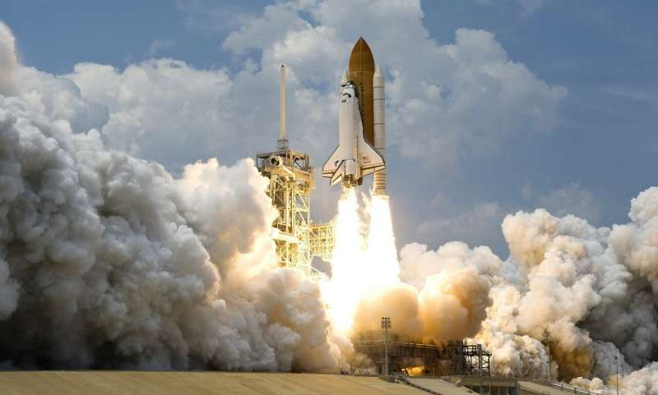
If ML is a rocket engine,
data is the fuel

Slide 73
Model Training

Slide 74
Model Training
DATA
MODEL

Slide 75
Model Training
Prediction
0
1
0
0
1
0
DATA
MODEL

Slide 76
Model Training
Prediction | Label
0 | 1
1 | 1
0 | 0
0 | 1
1 | 0
0 | 0
DATA
MODEL

Slide 77
Model Training
Prediction | Label
0 | 1
1 | 1
0 | 0
0 | 1
1 | 0
0 | 0
DATA
MODEL

Slide 78
Model Training
Prediction | Label
0 | 1
1 | 1
0 | 0
0 | 1
1 | 0
0 | 0
DATA
MODEL

Slide 79
Model Training
Prediction | Label
1 | 1
1 | 1
0 | 0
1 | 1
0 | 0
0 | 0
DATA
MODEL

Slide 80
Model Training
Prediction | Label
1 | 1
1 | 1
0 | 0
1 | 1
0 | 0
0 | 0
DATA
MODEL

Slide 81
Model Training
TRAINED MODEL

Slide 82
Model Training
MODEL
MODEL
MODEL
MODEL
MODEL

Slide 83
Evaluate the Model

Slide 84
Evaluate the Model
Training Data
Test Data

Slide 85
Train

Slide 86
Train
Test

Slide 87
Train
Test
Deploy

Slide 88
ML Process
Get Data
Prepare Data
Model Data
Refine Model
Deploy Model

Slide 89
ML Process
Get Data
Prepare Data
Model Data
Refine Model
Deploy Model
What data should you use?
Is it labeled?

Slide 90
ML Process
Get Data
Prepare Data
Model Data
Refine Model
Deploy Model
Is your data complete, clean, does it have coverage?

Slide 91
ML Process
Get Data
Prepare Data
Model Data
Refine Model
Deploy Model
Which algorithms should you use?

Slide 92
ML Process
Get Data
Prepare Data
Model Data
Refine Model
Deploy Model
What level of performance is sufficient?

Slide 93
ML Process
Get Data
Prepare Data
Model Data
Refine Model
Deploy Model
Make predictions.

Slide 94
Predictive Insights

Slide 95
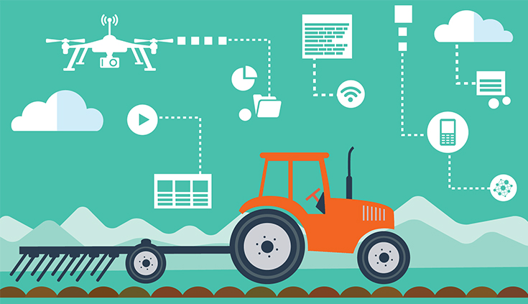
AgTech

Slide 96
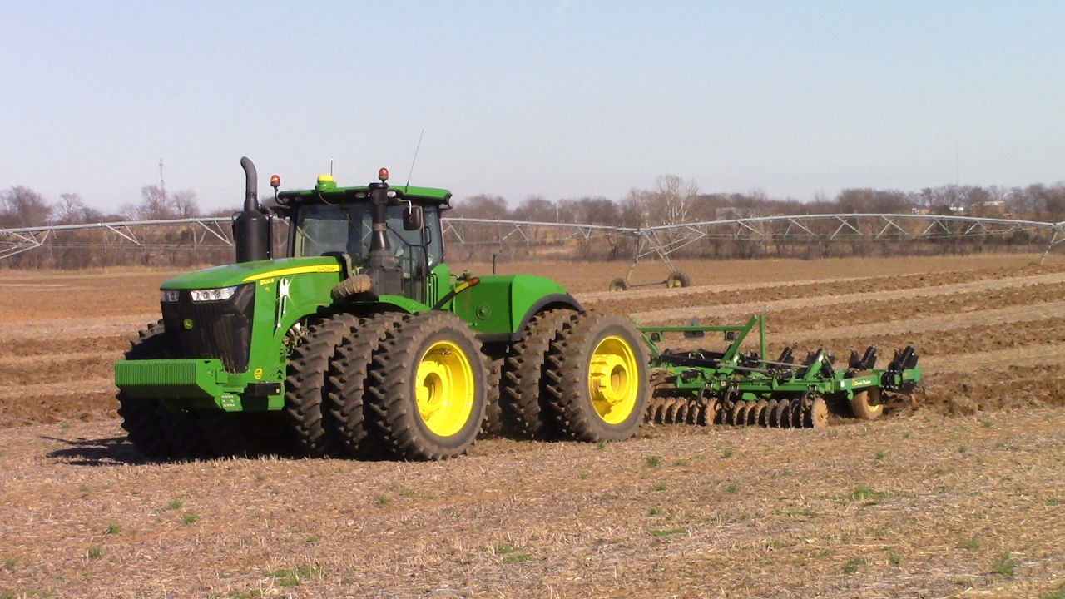
AgTech
Water Management
Plant Soil Analytics
Weather Forecasting
Predictive Machine Failure
Pest/Disease Identification

Slide 97
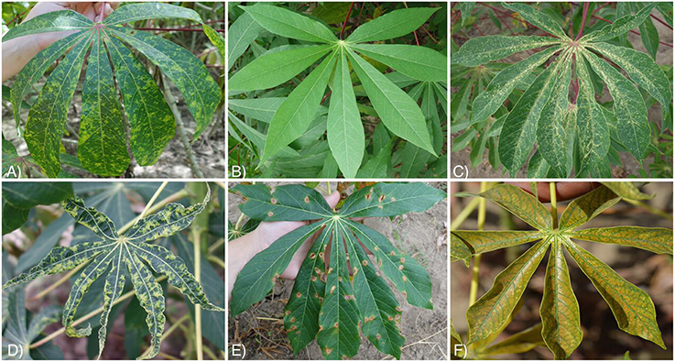

Slide 98
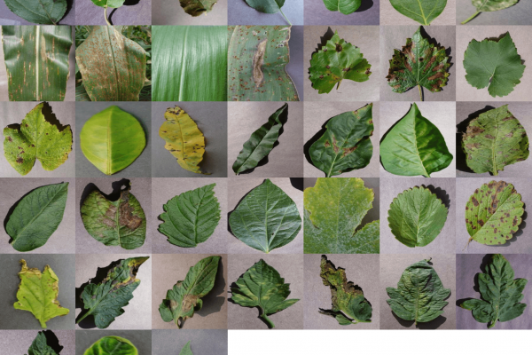

Slide 99
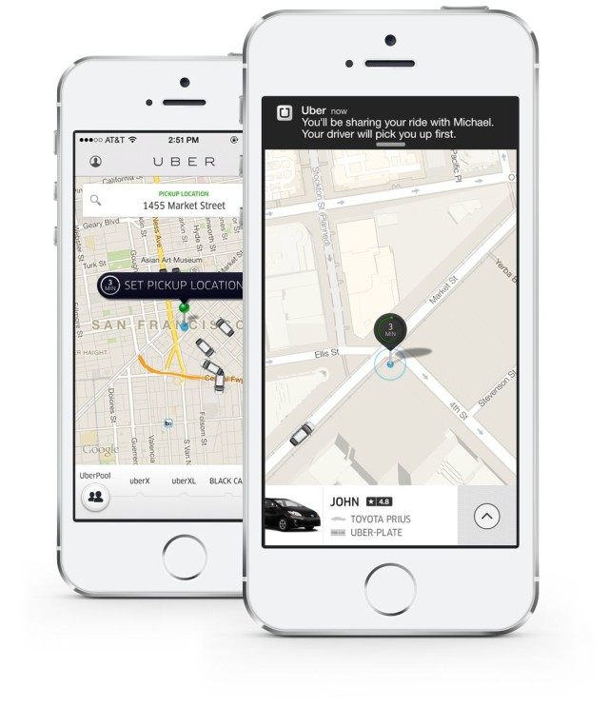


Slide 100
Machine Learning

Slide 101
Machine Learning
Supply-Demand

Slide 102
Machine Learning
Supply-Demand
Route Optimization

Slide 103
Machine Learning
Supply-Demand
Route Optimization
Rush Hour Pool

